Slide 1
Good Afternoon! Welcome to Year 3 and 4 Curriculum Meeting

Slide 2
Year 3 and 4 Team
Class Teachers
Holly – Mrs Bistram
Chestnut – Miss Patel
Ash – Mr Holliday and Mrs Root
Specialist Teachers
PE - Jack
Music -Mrs Osborne
Support Staff
Holly - Miss King
Chestnut - Mrs Hanley
Ash – Mrs Oosthuizen

Slide 3
School Vision
At Holland Junior School, we are a happy, friendly and caring school at the heart of our community. Hand in hand with our families, we have high expectations which nurture the successes, growth and happiness of every child. Children will leave our school with lasting memories and the skills to blossom in their future.

Slide 4
Soft Start Morning 8:30 – 9:00
At Holland Junior School we believe that in order to expect positive and respectful communication, we need to model and provide opportunities for it within our school day. Our soft start gives children time to settle, teachers and teaching assistants time to catch up with the children’s lives and allows them to feel happy and safe before we start learning.
Once they come into their room there will be music playing, questions on the whiteboard, books to read, and occasional curriculum catch up tasks to do.
Teachers and support staff in the room play a crucial role. They engage with children, support children's excitement of learning for the day and tutor. This morning routine is fundamental to driving Holland Junior School ethos as it develops independence, positive communication and well-being of every child.

Slide 5
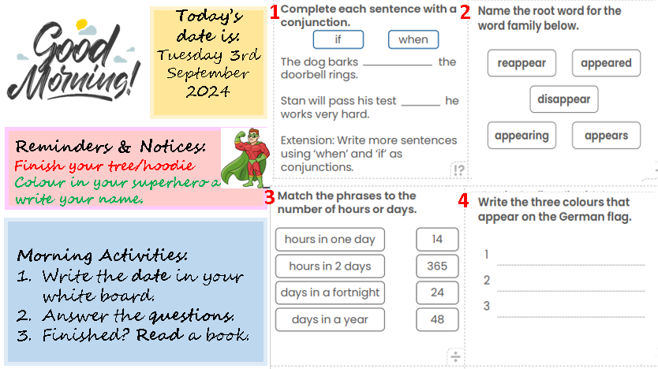
An example of our morning activity board.

Slide 6
Curriculum Offer at Holland Junior School
Subject | Curriculum Scheme
English (Reading) | CUSP Little Wandle (Rapid Catch Up interventions for anyone in need of phonic intervention)
English (Writing) | CUSP
Maths | White Rose Maths
Science, History, Geography, DT and Art | IPC
French | Kapow
Computing | NCCE
PE | PE PRO
RE | Bexley Scheme
PSHE | IPC and Kapow

Slide 7
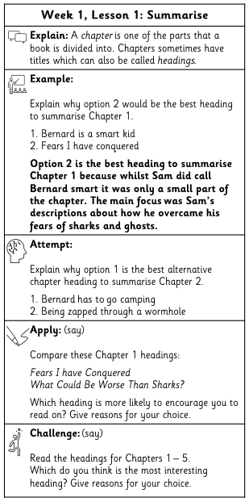
English
In Guided Reading, our book we will be reading is The Queen’s Nose by Dick King Smith.
In English we started by looking at different poetic devices and wrote and performed haikus and cinquains. We are moving onto persuasive adverts this week and then will be looking at diary entries.

Slide 8
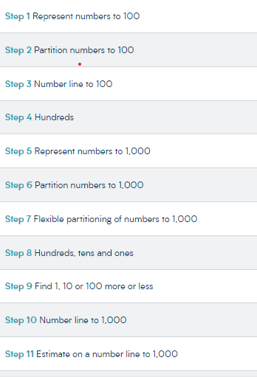
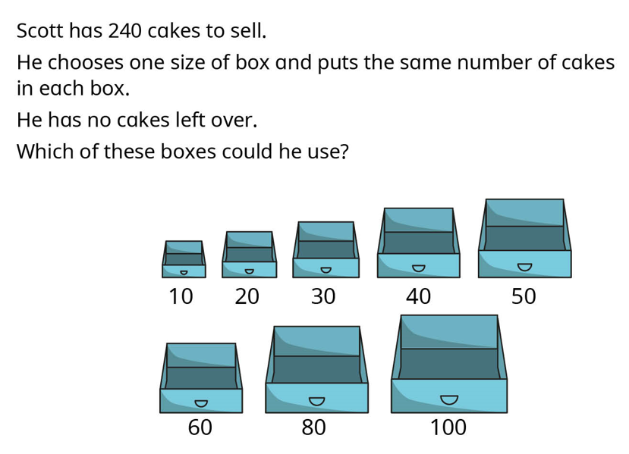
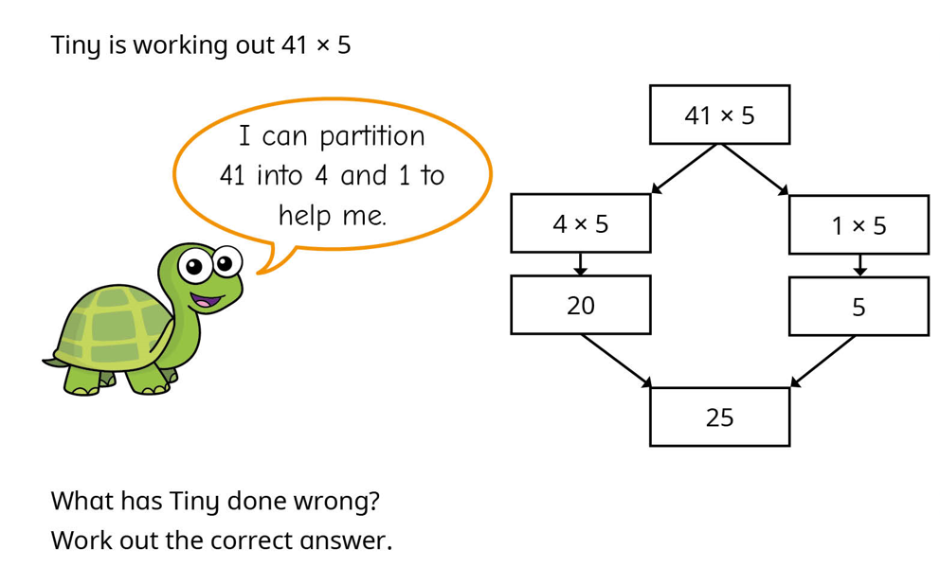
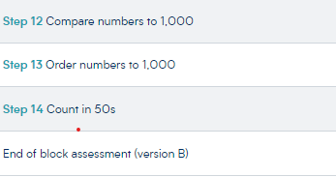
Maths
Every lesson, children are exposed to fluency, reasoning and problem solving.
These challenge questions are designed to make the children explain their reasoning, often requiring them to explain how they got to their answer.

Slide 9
IPC Topic: Brainwaves: Metacognition
This topic involves teaching the children how we learn, how we can look after our brain and about growth mindset.
After Brainwaves, our next unit is Temples, Tombs and Treasures where we will be looking at and comparing Ancient Egyptians and Ancient Sumerians.

Slide 10
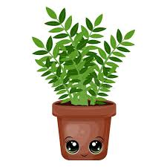
Our Topics
Autumn
Brainwaves: Metacognition
Temples, Tombs and Treasures
Making Waves
Spring
Land, Sea and Sky
Different Places, Similar Lives
Summer
All Aboard
Let’s Plant it/Feel the Force

Slide 11
Curriculum Letter and Topic web

Slide 12
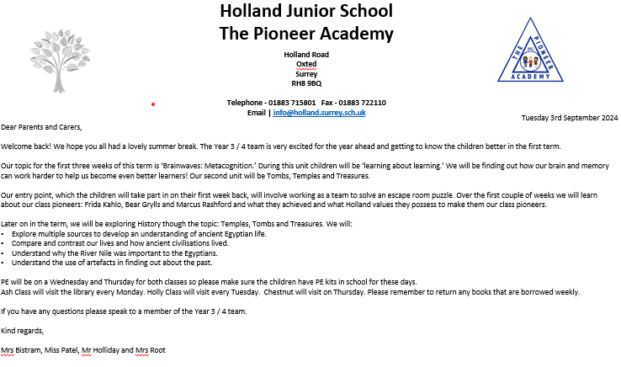
Curriculum Letter and Topic web

Slide 13
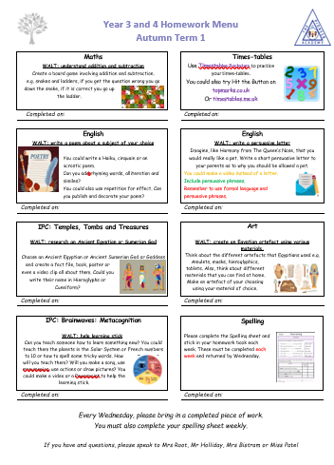
Homework
Homework menus
Spelling sheets
Reading Records
Times Tables Rock Stars and other sites

Slide 14
Questions?

