Slide 1
Good afternoon. Welcome to Years 5/6 Curriculum Meeting

Slide 2
Year 5/6 Team
Class Teachers
Willow – Miss Newton
Beech – Mrs Healy
Birch – Mr Kutchesfahani
Support Staff
Mrs Golsby
Mrs Yates
Miss Tiernan

Slide 3
School Vision
Every day at Holland Junior is an extraordinary school day. Our unwavering commitment in delivering an inspiring and inclusive curriculum develops independent learners. We endeavour to nurture inquisitive minds to enable them to become the best that they can be.

Slide 4
Soft Start Morning 8:30 – 9:00
At Holland Junior, we believe that in order to expect positive and respectful communication, we need to model and provide opportunities for it within our school day. Therefore we encourage all children to come to for at 8:30 am start.
Once they come into their room, they will do their Early Work which is usually handwriting and/or reading.
Teachers and support staff in the room play a crucial role. They engage with children, support children's excitement of learning for the day and tutor. This morning routine is fundamental to driving Holland Junior’s ethos as it develops independence, positive communication and well-being of every child

Slide 5
Curriculum Offer at Stewart Fleming
Subject | Curriculum Scheme
English (Reading) | Little Wandle (EYFS – Y2) CUSP
English (Writing) | CUSP
Maths | White Rose Maths
Science, History, Geography, DT and Art | IPC
French | Kapow
Computing | NCEE
PE | PE PRO
RE | Bexley Scheme
PSHE | Kapow

Slide 6
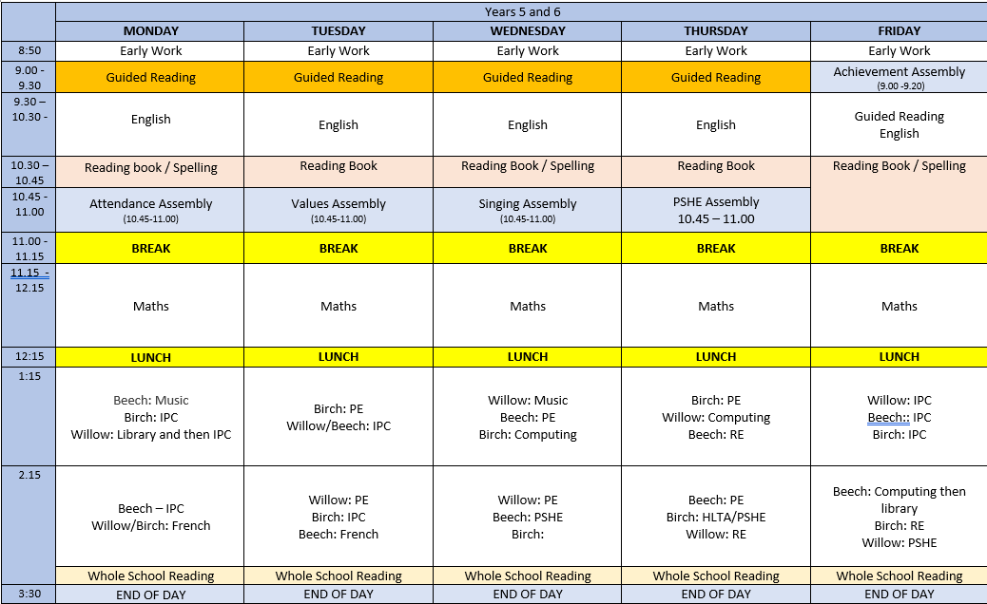
Timetable

Slide 7
Year 5/6’s Autumn 1
Topic Board

Slide 8
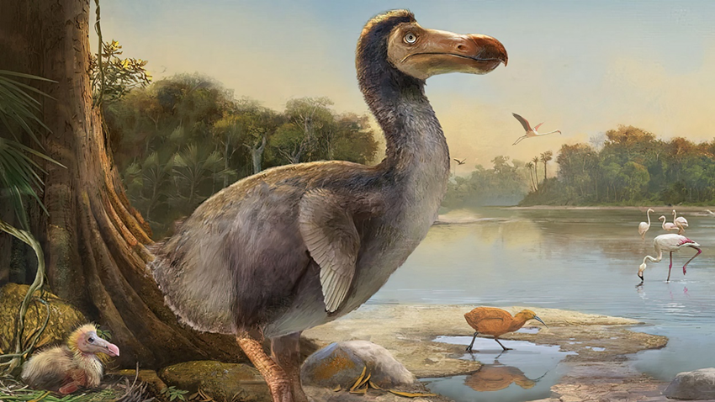
Year 5/6 Autumn Term 1
Brainwaves & Existing, Endangered, Extinct
As Mathematicians we will:
Areas to be covered: Roman numerals to 1,000, representing numbers to 10,000,000, counting in multiples of 10, 100, 1000, 10,000 and 1,000,000, comparing and ordering numbers to 1,000,000, rounding to 10, 100, 1000 and 1,000,000, addition, subtraction, multiplication, division, fractions.
Our planet is teeming with different species of living things that thrive and survive all over the world, some in extreme environments. In this unit the children will learn more about how we classify animals, how living things are adapted to their environments, and how all living things are interdependent. As part of the web of life, humans also have an important role to play. How is human behaviour threatening the survival of many species? Can we preserve the biodiversity of our planet?
As Writers we will:
Year 5s will be writing stories from other cultures and will be taught how to grammatically structure their sentences and paragraphs, create stamina to write an extended piece or two and most importantly, editing/up-levelling.
Year 6 will be covering the same skills as Year 5, however their writing focus will be based on writing their own autobiographies.
As learners of French we will:
learn about French transport: they will learn and apply strategies for working out the meaning of a new language, develop spontaneous speaking skills, use familiar vocabulary and language structures to describe a journey, conduct a survey and present the findings and to understand, express and justify a range of opinions.
As Readers we will:
In reading, Year 5 will learn about Shackleton’s Journey by William Grill. Children will experience: a letter, a report, an interview, a poem, an internal monologue and a narrative.
Year 6 will be using Rooftoppers by Katherine Rundell and will experience: an advertisement, a report, a recipe, a poem, a script and an interview.
As self-regulated learners, we will:
Families and relationships will be the topic for this half-term: this will include setting rules, friendship skills, respect, resolving conflict, family life, stereotyping, challenging stereotypes as well as changer and loss.
As Data Analysts in computing we will be:
This term will focus on how to deal with issues on-line, what is data, collecting and displaying data, how can formulae help in the real world and with mathematical problems and how a spreadsheet can be used to plan.
What can you do to help?
Make sure you are reading at least 3 times a week, practice your spellings and times tables and complete your homework weekly.
Positivity
Responsibility
Kindness
Respect
Respect
Honesty

Slide 9
PSHE
Families and relationships will be the topic for this half-term: this will include setting rules, friendship skills, respect, resolving conflict, family life, stereotyping, challenging stereotypes as well as changer and loss.

Slide 10
French
In this topic, children will learn about French transport: they will learn and apply strategies for working out the meaning of a new language, develop spontaneous speaking skills, use familiar vocabulary and language structures to describe a journey, conduct a survey and present the findings and to understand, express and justify a range of opinions.

Slide 11
English
Year 5s will be writing stories from other cultures and will be taught how to grammatically structure their sentences and paragraphs, create stamina to write an extended piece or two and most importantly, editing/up-levelling.
Year 6 will be covering the same skills as Year 5, however their writing focus will be based on writing their own autobiographies.

Slide 12
Reading
In reading, Year 5 will learn about Shackleton’s Journey by William Grill. Children will experience: a letter, a report, an interview, a poem, an internal monologue and a narrative.
Year 6 will be using Rooftoppers by Katherine Rundell and will experience: an advertisement, a report, a recipe, a poem, a script and an interview.

Slide 13
RE
In R.E, we will understand that beliefs can influence our actions, that beliefs of others can be changed, the concept of self-worth and what forgiveness and honesty are.

Slide 14
Maths
Areas to be covered: Roman numerals to 1,000, representing numbers to 10,000,000, counting in multiples of 10, 100, 1000, 10,000 and 1,000,000, comparing and ordering numbers to 1,000,000, rounding to 10, 100, 1000 and 1,000,000, addition, subtraction, multiplication, division, fractions
(equivalence and simplifying, comparing and ordering, improper fractions and mixed numbers, counting in fractions and adding and subtracting).

Slide 15
P.E.
This half-term, we will be focussing on fundamental skills as well as football.

Slide 16
ICT /Computing
This term will focus on how to deal with issues on-line, what is data, collecting and displaying data, how can formulae help in the real world and with mathematical problems and how a spreadsheet can be used to plan.

Slide 17
Music
This term in music we will be learning about the music of South Africa. We will be singing songs from South Africa and other African countries. We will be reading and playing staff notation using glockenspiels and composing and notating our own rhythmic patterns for a traditional gumboot dance. We will also be listening to and appraising music from South Africa

Slide 18
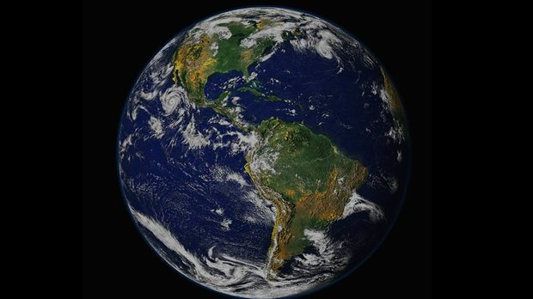
This half term our IPC topic is:
Existing, Endangered, Extinct
Our planet is teeming with different species of living things that thrive and survive all over the world, some in extreme environments. In this unit the children will learn more about how we classify animals, how living things are adapted to their environments, and how all living things are interdependent. As part of the web of life, humans also have an important role to play. How is human behaviour threatening the survival of many species? Can we preserve the biodiversity of our planet?

Slide 19
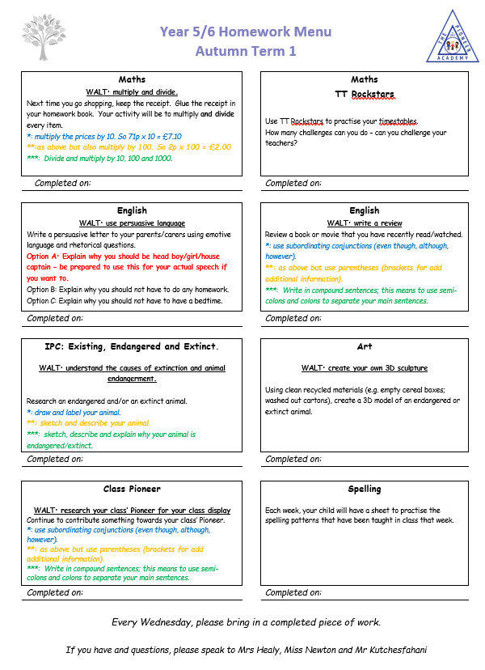
Homework
Homework
Reading Records
Times Tables

Slide 20
Parental Engagement
Please support us to support your children – we are on your side
Year 6:
Secondary schools
Isle of Wight
SATs week

Slide 21
Questions?
Teaching assistants are with teachers but not all day – this had never been confirmed according to the head teacher;
Miss Graham will train teachers how to use VRs to assist with science lessons;
Forest school will begin in blocks after half-term;
There will be a meeting for all year 6 parents/carers next Thursday 26th September at 3:35pm in Mr K’s classroom. The meeting will focus on KS2 SATs, secondary schools admissions and the trip to the Isle of Wight.

